Slide 1
Applied Data Science מדע נתונים יישומי
Dr. Omri Allouche
2017

Slide 2
Applied data science
Class #224
Wednesdays 11am-2pm
No Tirgul Classes

Slide 3
Who Am I?
Omri Allouche
PhD in Computational Ecology from HUJI
Senior Data Scientist @ Gong.io
In the past – startup entrepreneur, R&D team leader @ Elisra
No set office hours – coordinate by email
omri.allouche@gmail.com

Slide 4
The state of data

Slide 5
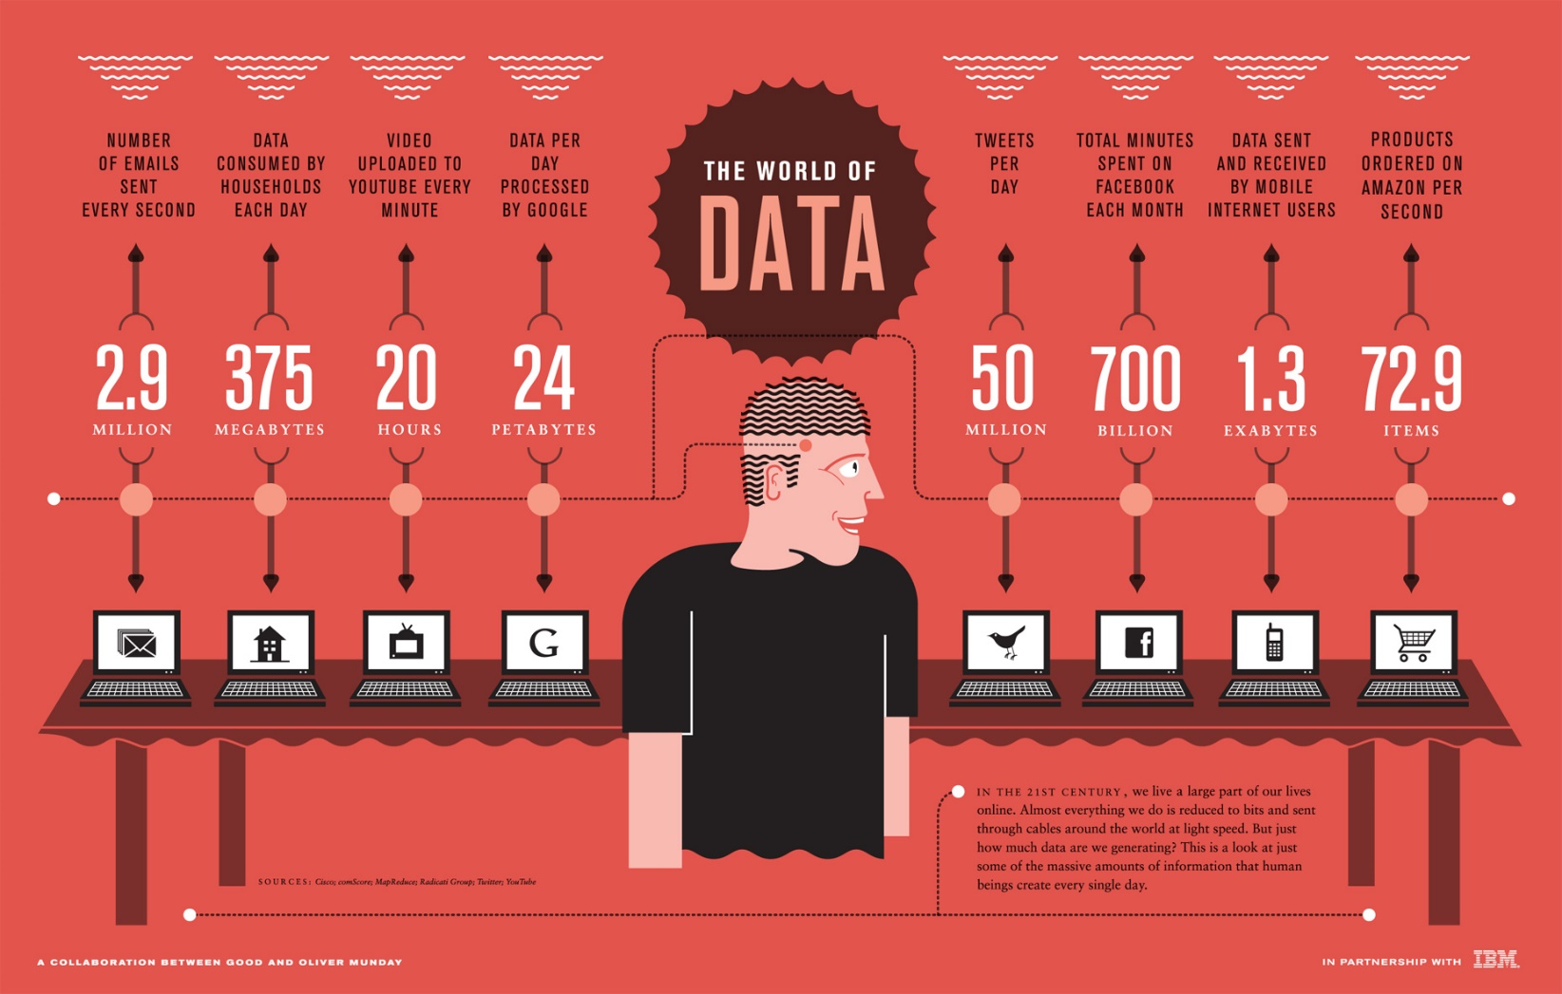
Source: bimeanalytics.com

Slide 6
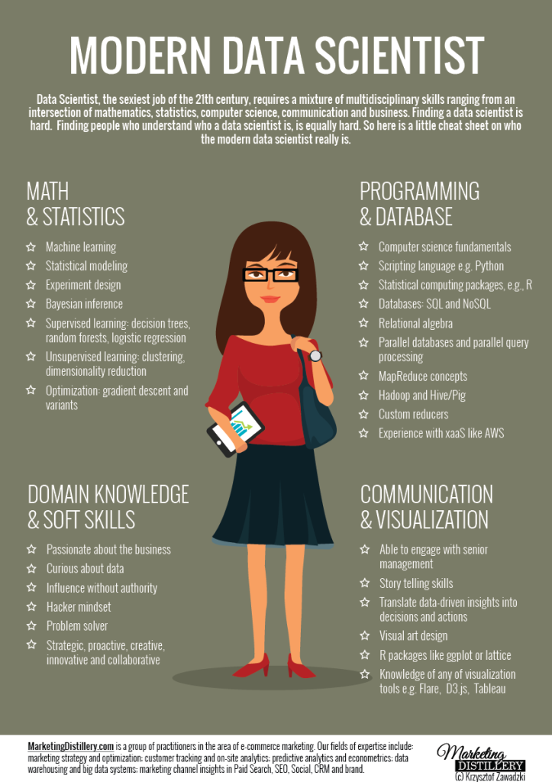
Source: marketingdistillery.com

Slide 7
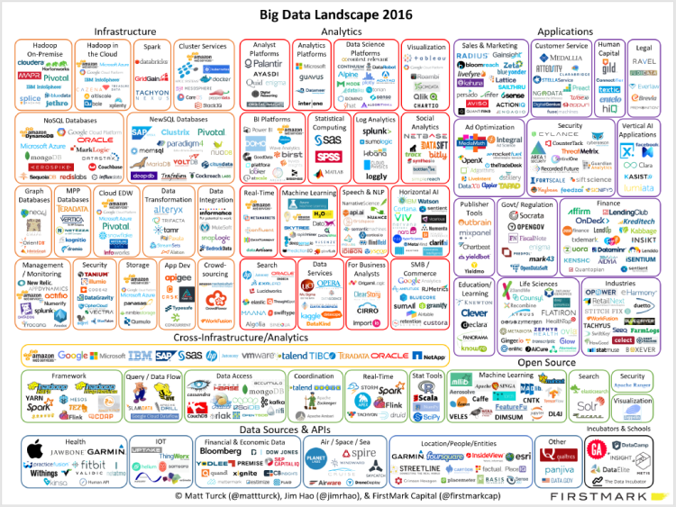
Source: http://mattturck.com/2016/02/01/big-data-landscape/

Slide 8
A Single Course Won't Make You a (Good) Data Scientist
Data Science is booming
Pace of progress is unparalleled
There's no silver bullet
No real out-of-the-box solutions
A few rules, meant to be broken
You have to be able to learn on your own, constantly

Slide 9
You're Learning a New Language
Immerse yourself in the new language
Read. A lot
Read. In English
Don’t be intimidated if you don’t understand everything, or even most of the things
Learn how you learn, and use it
There are great video courses & lectures online (list follows)
Weekly Meetups are held in Israel
Many books & blog articles, for all levels
Podcasts
Kaggle competitions

Slide 10
You're Learning a New Language
If you can't understand a concept from a specific source, try finding another one
Find a partner
Learn like a child. Experiment, and make mistakes
Learn a bit every day
Keep notes of what you don't know (or better yet, use the Spaced Repetition method)

Slide 11
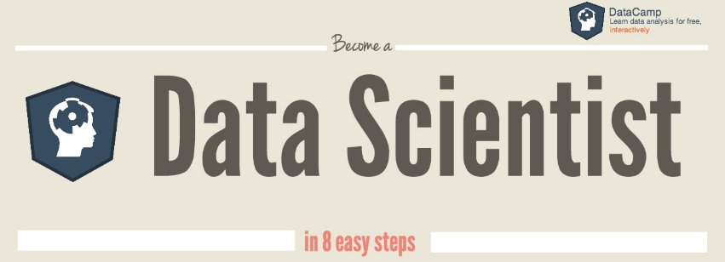
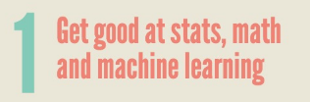
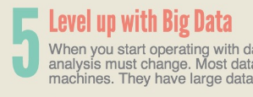
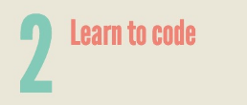

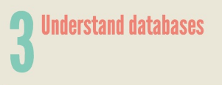
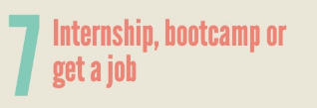
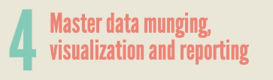
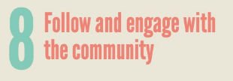
Source: https://www.datacamp.com/community/tutorials/how-to-become-a-data-scientist

Slide 12
Course Syllabus
Python for Data Analysis
Information Visualization
Exploratory Data Analysis
Applied Machine Learning

Slide 13
Lectures Plan
Lessons usually include
a quick, non-mathematical review of an algorithm
discussion of code for implementing it
a hands-on exercise,
discussion in class
We will not go into the mathematical details of the algorithms
We will discuss important concepts in data science and machine learning
You should come prepared for each lesson
Read the reading list
Freshen up on the algorithm that will be discussed
Main Assumption – we’re all here because we want to

Slide 14
Course Grading
Mostly based on a final project
Small part due to personal assessment - participation in class, bonus tasks etc.
No exam
Participation in class is mandatory

Slide 15
Final Project
In groups of 2-3
Go through the complete data science process
You will acquire the data, explore it for interesting patterns, design your visualizations, run statistical analysis, and communicate the results
Use the tools you've learned during the course
You select the research question and dataset
We'll provide datasets from Israeli government authorities, HiTech companies

Slide 16
Final Project
Phases:
Form groups
Submit a project proposal
Periodic project reviews
Final submission
Project should include:
Code on GitHub - well written, well documented!
Accompanying paper, describing the question, related work, methods, results and discussion, as a Jupyter Notebook
A 2 minute Screencast / Presentation in Class. Instructions on creating a screencast can be found here
For ideas for projects, check out some of the projects done during Harvard's CS109 course in 2014 and 2015

Slide 17
Project Paper
Should include the following sections:
Overview and Motivation: Provide an overview of the project goals and the motivation for it. Consider that this will be read by people who did not see your project proposal.
Related Work: Anything that inspired you, such as a paper, a web site, or something we discussed in class.
Initial Questions: What questions are you trying to answer? How did these questions evolve over the course of the project? What new questions did you consider in the course of your analysis? - Data: Source, scraping method, cleanup, storage, etc.
Exploratory Data Analysis: What visualizations did you use to look at your data in different ways? What are the different statistical methods you considered? Justify the decisions you made, and show any major changes to your ideas. How did you reach these conclusions?
Final Analysis: What did you learn about the data? How did you answer the questions? How can you justify your answers?
Presentation: Present your final results in a compelling and engaging way using text, visualizations, images, and videos on your project web site.

Slide 18
You're Learning a New Language
Immerse yourself in the new language
Read. A lot
Read. In English
Don’t be intimidated if you don’t understand everything, or even most of the things
Learn how you learn, and use it
There are great video courses & lectures online (list follows)
Weekly Meetups are held in Israel
Many books & blog articles, for all levels
Podcasts
Kaggle competitions

Slide 19
You're Learning a New Language
If you can't understand a concept from a specific source, try finding another one
Find a partner
Learn like a child. Experiment, and make mistakes
Learn a bit every day
Keep notes of what you don't know (or better yet, use the Spaced Repetition method)

Slide 20
Python Crash Course

Slide 21
Python Crash Course
This lesson provides a quick introduction to the Python language. It assumes you know the basic concepts of programming, including basic data types, conditionals, loops, functions etc.
For a more in-depth review of Python and programming, I recommend the following resources, which were the source for many of this course’s material:
Python Data Science Handbook (Book, Paid)
Complete Python Bootcamp on Udemy (Video course, Paid). The course's Jupyter Notebooks are here.
Python 3 Essential Training on Lynda.com (Video course, Paid)

Slide 22
The Python Language
Developed by Guido van Rossum in the early 1990s
Named after Monty Python
Open source general-purpose language
Becoming a standard in scientific computing
Easy to use and learn
Interpreted language: work with an evaluator for language expressions
Dynamically typed: variables do not have a predefined type
Rich, built-in collection types (Lists, Tuples, Dictionaries (maps), Sets)
Concise
Object Oriented, Procedural, Functional
Great interactive environment
Much slower than C/C++ (though wrappers exist)

Slide 23
Dynamic typing – the key difference
Java: statically typed
Variables are declared to refer to objects of a given type
Methods use type signatures to enforce contracts
Python
Variables come into existence when first assigned to
A variable can refer to an object of any type
All types are (almost) treated the same way
Main drawback: type errors are only caught at runtime

Slide 24
The basics of Python code
Indentation matters to the meaning of the code:
Block structure indicated by indentation
The first assignment to a variable creates it
Variable types don’t need to be declared
Python figures out the variable types on its own
Assignment uses = and comparison uses ==
Logical operators are words (and, or, not) not symbols

Slide 25
Whitespace
A whitespace is meaningful in Python: especially indentation and placement of newlines.
Use a newline to end a line of code
Use \ when must go to next line prematurely
No braces { } to mark blocks of code in Python... Use consistent indentation instead
The first line with less indentation is outside of the block
The first line with more indentation starts a nested block
Often a colon appears at the start of a new block (e.g. for function and class definitions)

Slide 26
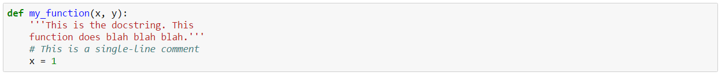
Comments
Start comments with # – the rest of line is ignored.
Can include a “documentation string” as the first line of any new function or class that you define.
The development environment, debugger, and other tools use it: it’s good style to include one.

Slide 27
Why Python 3?
Cleaner and faster
Has inherent glitches and minor drawbacks fixed
It is the future!
Python 3 has been around for over 5 years

Slide 28
Let’s start playing with some code

Slide 29
Follow along using IBM DSX
For future lessons, you’ll install your own Python environment locally
For this lesson, open http://datascience.ibm.com/
Sign in / sign up (free)
Create a new Project named “ADS” (use defaults settings)
Click “Add Notebooks” > “From URL”
Use “Python Part 1” for name, and https://github.com/omriallouche/applied-data-science/blob/master/Python%20Crash%20Course/Part%201.ipynb for url
A machine will start in the cloud, allowing you to run the code yourself

Slide 30
Jupyter Notebook
Web app, served from localhost / web server
Runs a Python kernel in the background, and outputs its results
Combines markdown, code and code results
Becomes the standard for creating reproducible data science
Saved as ipynb files
Rendered in GitHub
Can be extended to include section folding, run time logging, interactive widgets, Reveal.JS presentations and more

Slide 31
DATA Nuggets

Slide 32
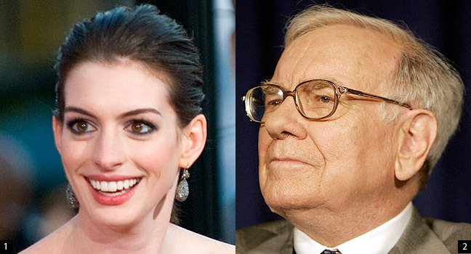
How are these two related?
Source: The Atlantic
Notes:
https://www.theatlantic.com/technology/archive/2011/03/does-anne-hathaway-news-drive-berkshire-hathaways-stock/72661/

Slide 33

“This Machine Turns Trump Tweets into Planned Parenthood Donations” (by Max Braun)

Slide 34
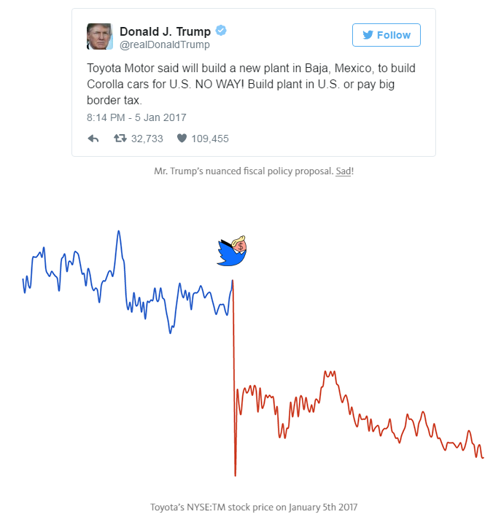

Slide 35
DATA Nuggets

Slide 36
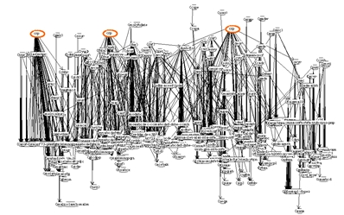

Slide 37
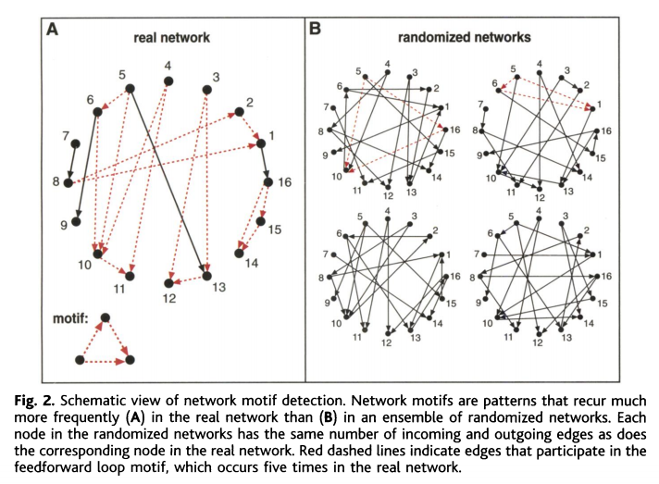

Slide 38
Final notes

Slide 39
Homework – part 1
Familiarize yourself with Jupyter Notebooks. Get to know:
Keyboard Shortcuts
Markdown syntax
Follow Scikit Learn’s basic Introduction to Machine Learning (make sure you run the code yourself, using Jupyter Notebook!)
Watch 2 Project Videos submitted for Harvard’s CS109 (search YouTube for “CS109”). Email omri.allouche@gmail.com with a list of terms from each video, each marked with:
1 – don’t know anything about it
2 – have a vague idea what it is
3 – I know it pretty well

Slide 40
Homework – part 2
Install an RSS feed app on your mobile phone (I recommend Feedly), and subscribe to the RSS feed of Analytics Vidhya
Subscribe to the weekly newsletter of Data Machina
Sign up to meetup.com and join a few groups related to data science
Read "A Few Useful Things to Know about Machine Learning"

Slide 41
Requested Topics?
Databases and SQL
Natural Language Processing
Neural Networks and Deep Learning
Big Data Tools (Hadoop, Spark)

Slide 42
recommended materials

Slide 43
Online Courses
Google’s Python Class - https://developers.google.com/edu/python/
DataCamp’s Interactive Tutorials - https://www.datacamp.com/courses/intro-to-python-for-data-science
EdX - https://www.edx.org/course/introduction-python-data-science-microsoft-dat208x-4#!
https://classroom.udacity.com/courses/ud120/lessons/2410328539/concepts/24185385370923#
CodeAcademy - https://www.codecademy.com/learn/python
https://www.udacity.com/course/intro-to-descriptive-statistics--ud827

Slide 44
Reading
An elaborate guide to Python with examples
https://github.com/jakevdp/PythonDataScienceHandbook
http://www3.canisius.edu/~yany/python/Python4DataAnalysis.pdf
https://datajobs.com/what-is-data-science

